Slide 1

Connected Operations (COps) Platform
Team 32: Caleb Boswell, Spencer Yoder (Presenters), Jonathan Balliet, Daniel Mills, Jeen Shaji
Notes:
Good afternoon everyone. I am Jeen Shaji. Me and Jonathan will be presenting about our project Connected Operations platform

Slide 2
Content
Project Recap
Requirements
Design
Demo
Current Iteration
Action Steps
Notes:
We will do a short recap of our project, requirements and design. Followed by a quick demo, current iteration updates and planned action steps

Slide 3
Project Recap
Skyward Federal: Cyber-Logistics startup
Create secure custom applications for government clients
Data is usually separated physically by security level
Inefficient and multiple points of failure
Problem: how to create a centralized, virtualized, multi-level security data store?
Notes:
Skyward federal is a cyber-logistics startup with about 10 employees. They create secure custom application for government clients.
To solve this, Skyward federal wants us to create a Common Operations Platform

Slide 4
Overall Requirements
The system shall receive data from multiple external sources
The system shall categorize, label, and store data
Users shall be able to read data, write data, and view reports
The system shall execute or deny requests based on the user’s security context
The system shall be interfaced via an API endpoint
Notes:
System receives data from n number of external sources
For example: Categories like unclassified, confidential, secret and top secret
System allows user interaction with the database. They can read and write
** System will either approve or deny this access request based on their security context.

Slide 5
Constraints
SELinux..
System shall run on CentOS 7 with SELinux enabled
PostgreSQL shall be used as our database
Docker Containers shall be used to run RESTful services
Notes:
Skyward Federal wants the system to run on a CentOS 7 with SELinux. SELinux is used as our security module
They also want us to use postgreSQL as our database because of its integration with SELinux
We can see from our requirements that these are very abstract. In iteration 1, we specified a concrete system which fulfills all these abstract requirements. It is called the COURSE MANAGER.

Slide 6
Course Manager
3 Users: Coordinator, Instructor and Student
 | UC 1 | UC 2 | UC 3 | UC 4 | UC 5 | UC 6 | UC 7
 | Login | View Account | Edit Course | Edit User | Edit Grade | View Schedule | View Logs
Coordinator
Instructor
Student
Notes:
UC 1, 2, and 4 were previously completed
UC 3, 5, and 6 are now completed (if we get done in time)
For our mock system called Course Manager, we have 3 users: Coordinators, Instructors and Students.
We have a total of 7 use cases. All of which can be done by the coordinator.
We see see that an instructor can do 4 of these while a student has limited access.
We currently have UC1, 2 and 4 completed. We will see this in the demo later

Slide 7
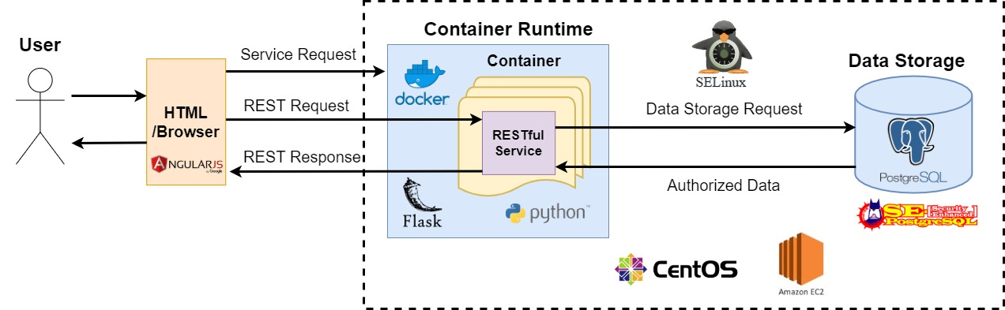
Overall Design

Slide 8
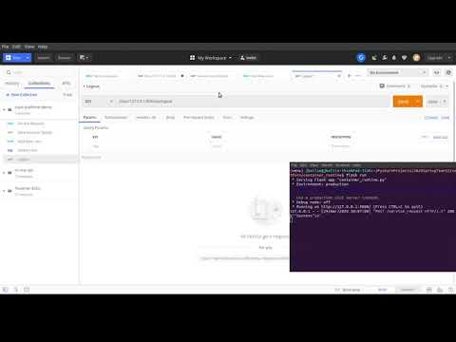
Demo
JB

Slide 9
Overall Design

Slide 10
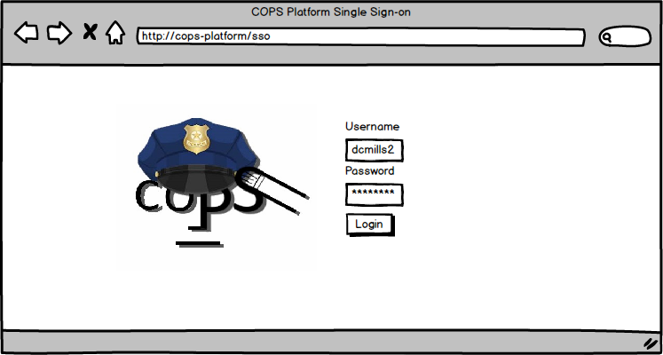
COps Platform - Front-end Interface

Slide 11
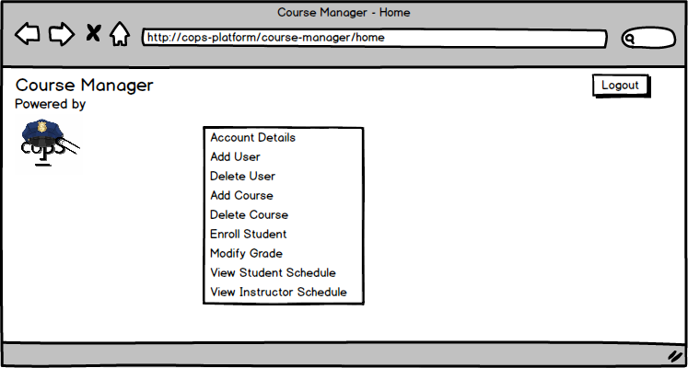
Course Manager - Home Page

Slide 12
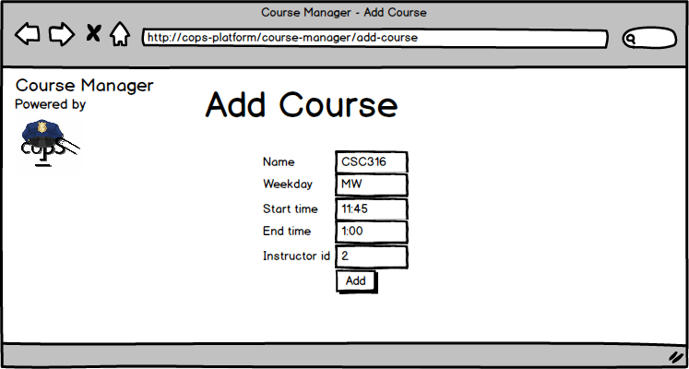
Course Manager - Add Course

Slide 13
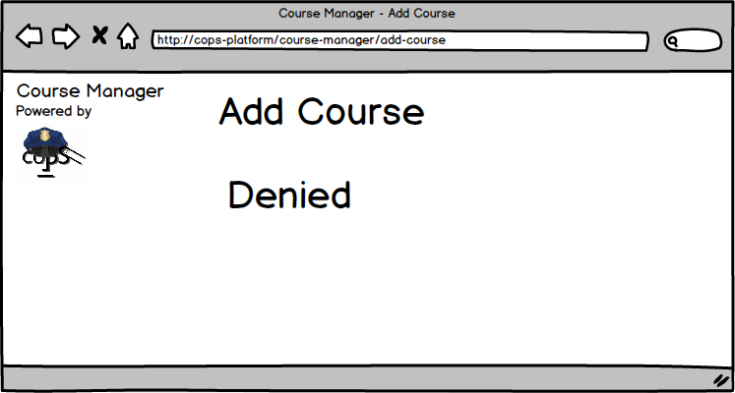
Course Manager - Denied!

Slide 14
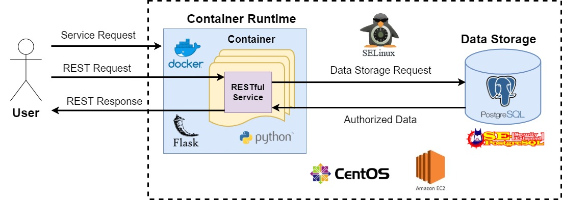
Overall Design
Notes:
How to secure the system? Depends on SELinux integrated with all components.

Slide 15
SELinux Policy
SY
Notes:
This was our previous SELinux Policy

Slide 16
Iteration 2 - SELinux Policy Changes
SELinux Policy changes since last time
Moved from a modified MLS policy to a simpler type enforcement policy
Now, we have types for each user and can manually designate which data types are accessible to which user types
Example:
postgres_u:coursemanager_r:instructor_t:s0
system_u:object_r:course_student_mapping_t:s0
SY & DM
Notes:
Understanding of SELinux has changed, along with struggling with how complicated it is
Now using type enforcement
Basically does the same thing as MLS (restricting what a running process is allowed to do) but easier for us to implement. We agreed with our sponsors on this change
Created a full custom policy module which mocks the kinds of operations performed by CourseManager
The top one is for the instructor user, the bottom one is for the course_student_mapping table

Slide 17
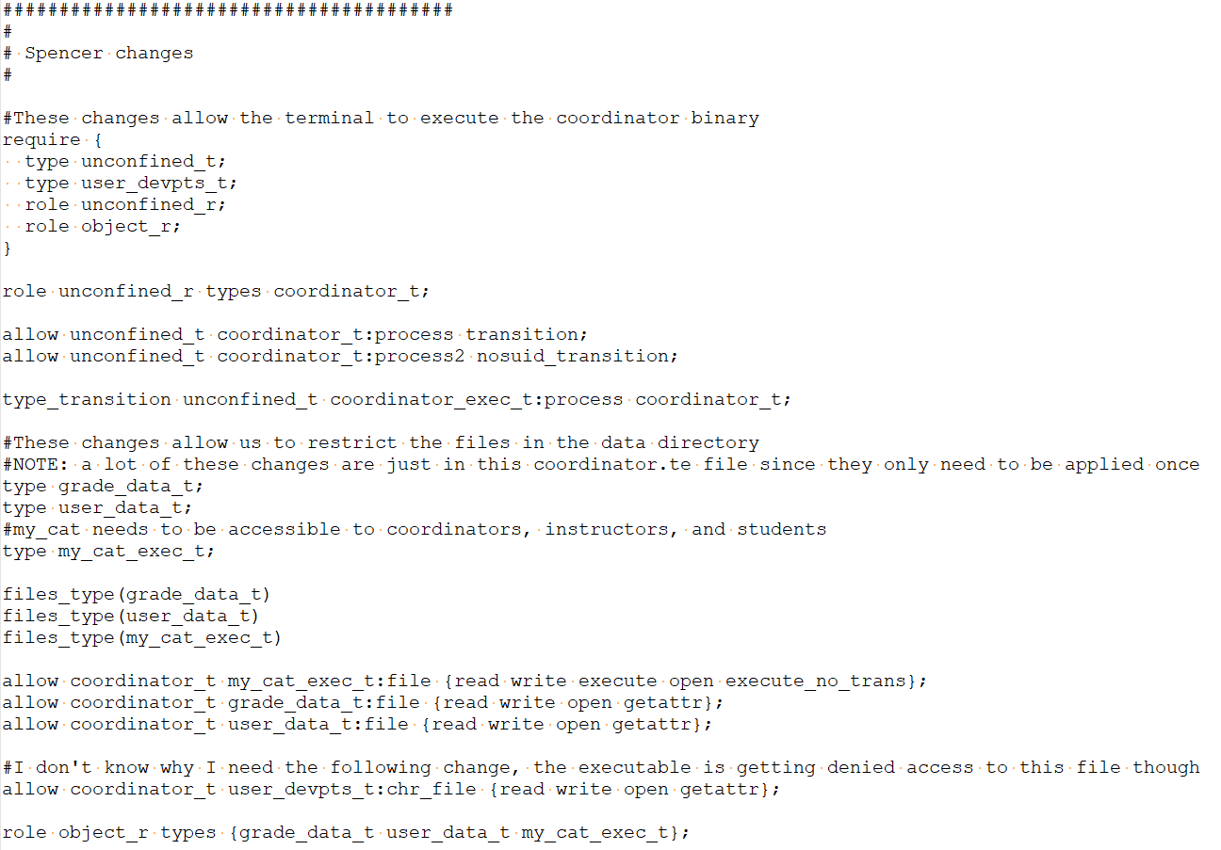
Code: SELinux Policy Modules
Preexisting SELinux types
Start up a process with a new context
Create new data types
Create new SELinux rules
SY
Notes:
Example of our coordinator process policy
Require - reference stuff that is already created (like importing libraries)
Create the coordinator process with a newly defined security context
Define new data types that will be used in this security policy
Create the SELinux rules for this coordinator process
Enforces what the process can do to the defined data types (read, write, execute, etc.)

Slide 18
Status of Project
Our goal:
CentOS 7 Machine
User
Docker Container
REST Requests
CourseManager
Postgres Database
SELinux Security Policy
JSON responses
SY
Notes:
Our Goal is to have all components : Course Manager, Docker and POstgres working on a centOS 7 machine with SELinux enabled

Slide 19
Status of Project
Our current status:
CenOS 7 Machine
User
Docker Container
REST Requests
CourseManager
Postgres Database
SELinux Security Policy
JSON responses
SY
Notes:
Now have all components working (with SELinux in Permissive mode) on CenOs 7 Machines
SELinux Policy is in development

Slide 20
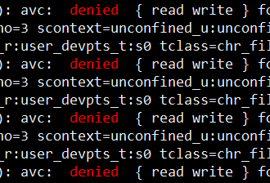

Challenges
SELinux is complicated, and poorly documented
Difficulty integrating SELinux with a Docker Container
Resolutions
Creating our own documentation
Coming up with alternative methods to enforce SELinux with Docker
DM, CB, & SY

Slide 21
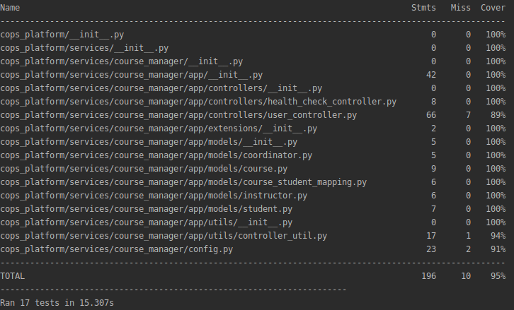
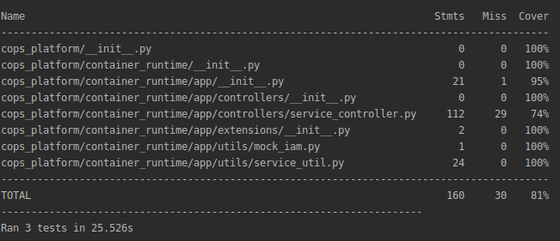
Testing Progress
Unit and Integration Tests - Completed for UCs 3, 5, 6
Coverage
Course Manager - 95 %
Container Runtime - 81 %
System Tests - Tests are planned but need SELinux integrated to do them
JB, CB, & JS
Notes:
We need to bring everything together on the CentOS 7 development machine and integrate with the SELinux module
This way we can finally do System Testing for the security of our system.

Slide 22
Action Steps
Finish Iteration 2 (April 10th)
Integrate Course Manager on CentOS 7 enabled with SELinux
Have one REST API correctly working in our end-to-end in system
Make progress on developers guide and installation guide
Start frontend code
Iteration 3 (April 21st)
Finish remaining Use Cases for Course Manager
System Testing for all REST API calls
Integrate SELinux policies with Docker Container
Finish developers, installation and user guide
JS & JB

Slide 23
Conclusion
Installed Course Manager and Container Runtime on development machines
Coded SELinux policies and began integration with database and the Container Runtime
Completed Course Manager use cases 3, 5, and 6
Designed front-end interface and began integrating with back-end
Need to finish integrating everything together and complete our system tests!
DM & JB

